Slide 1






She4Tech
Page 01
She4Tech AI Chatbot System
An Object-Oriented C++ Inquiry Management System
SDG Goal: Industry, Innovation, and Infrastructure (SDG 9)
BSIT 1st Year | CC103 – Computer Programming 2
Defense Presentation

Slide 2











She4Tech AI Chatbot
Page 02
PROJECT OVERVIEW
A console-based C++ application designed for automated inquiry responses and customer record management, improving interaction, automating responses, storing data, and demonstrating OOP concepts.

Slide 3


























PROBLEM STATEMENT
She4Tech AI Chatbot
Page 03
Manual processes result in delayed responses to customer inquiries, causing frustration and potential loss of engagement.
Manual inquiry handling creates significant challenges for organizations, leading to inefficiencies and poor customer experiences that demand an automated solution.
Slow Response Time
Lack of Automation
Manual processes result in delayed responses to customer inquiries, causing frustration and potential loss of engagement.
Repetitive tasks consume valuable time and resources when handled manually, reducing overall productivity and efficiency.
Poor Data Organization
Difficulty Tracking Inquiries
Without proper systems, organizing and retrieving customer data becomes chaotic, leading to lost information and repeated inquiries.
Monitoring inquiry status and history becomes nearly impossible without a centralized tracking system in place.

Slide 4























She4Tech AI Chatbot System
Page 04
General Objective
1
Develop a chatbot inquiry management system using Object-Oriented Programming concepts in C++.
OBJECTIVES
Specific Objectives
2
Create an interactive chatbot interface, store customer inquiries efficiently, and generate comprehensive reports.
Clear statement of the general and specific goals that guide the development of the She4Tech AI Chatbot System using Object-Oriented Programming principles.
Technical Implementation
3
Apply file handling for data persistence and implement secure admin access with password authentication.
Learning Outcomes
4
Demonstrate mastery of OOP principles including encapsulation, classes, and methods in a practical C++ application.

Slide 5

















She4Tech AI Chatbot
Page 05
FEATURES OF THE SYSTEM
The She4Tech AI Chatbot System incorporates eight powerful features designed to streamline customer inquiry management and demonstrate professional-grade C++ programming.
AI-Style Chatbot Responses
Admin Login Security
Intelligent AI-style responses provide automated, context-aware replies to customer questions instantly.
Secure admin login with password authentication protects sensitive data and restricted system features.
Summary Report Generation
Typing Effect Animation
Generates comprehensive summary reports of all customer inquiries for easy tracking and analysis.
Typing effect animation creates realistic conversation feel, enhancing user experience and engagement.

Slide 6




















She4Tech AI Chatbot System
Page 06
Encapsulation
1
Private data members protect sensitive information while public getters and setters provide controlled access to class attributes.
Constructor Initialization
OOP CONCEPTS USED
2
Constructors initialize inquiry objects with proper default values, ensuring data integrity from the moment of object creation.
The She4Tech AI Chatbot System demonstrates core Object-Oriented Programming principles, utilizing well-structured classes and methods to create a maintainable and scalable inquiry management solution.
Classes Implemented
3
Inquiry Class and ChatbotManager Class organize functionality into logical units for better code structure.
Key Methods
4
loadData(), saveData(), generateBotResponse(), and searchInquiry() methods handle core system operations efficiently.

Slide 7






















She4Tech AI Chatbot System
Page 07
SYSTEM FLOWCHART
Start
Menu
Select
Option
Process
Request
Save
Data
Exit

Slide 8





















She4Tech AI Chatbot
Page 08
FILE HANDLING
1.
Data Storage Methods
2.
Purpose of Persistence
Uses ifstream to load data and ofstream to save data.
Prevents data loss between sessions and maintains persistent customer inquiry records for future access.
Database file: database.txt stores all customer records.
The system implements C++ file handling using ifstream and ofstream classes to read and write customer inquiry data to database.txt, ensuring data persistence across program sessions.

Slide 9















INPUT VALIDATION
She4Tech AI Chatbot
Page 09
& SECURITY
Input Validation
1
Prevents empty name/email inputs, blocks invalid menu selections, and implements defensive programming to avoid system crashes.
Security Measures
2
Admin password authentication protects restricted features.Default password: admin123. Only authorized users can access admin functions.
Data integrity and system security are ensured through comprehensive input validation and password-protected admin access, preventing unauthorized operations and maintaining reliable system performance.

Slide 10



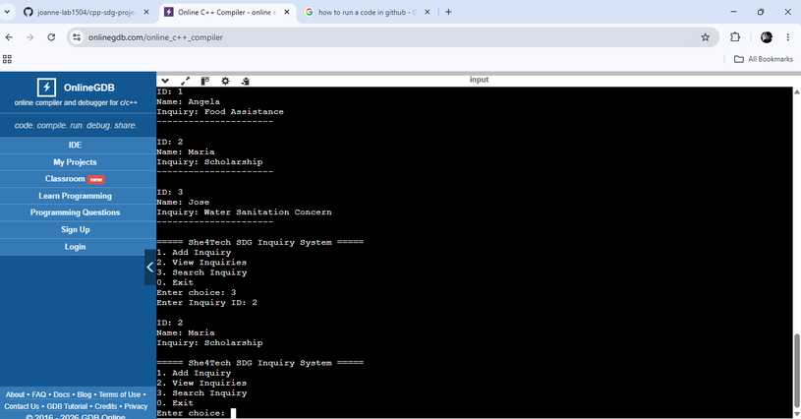





She4Tech AI Chatbot
Page 10
SAMPLE PROGRAM OUTPUT
Main Menu & Chatbot Conversation
Displays the interactive menu and AI-style chatbot responses with typing animation effect.
Inquiry List & Summary Report
Shows stored customer inquiries and generated summary reports with file handling output.

Slide 11





















She4Tech AI Chatbot
Page 11
CHALLENGES ENCOUNTERED
Throughout development, several technical hurdles required creative problem-solving and iterative refinement to overcome, strengthening both the system and programming skills.
Implementing OOP Structure
Managing Vectors & File Handling
1
Structuring code with proper classes, inheritance concepts, and maintaining clean separation of concerns required careful planning.
2
Working with vectors for dynamic data storage and implementing file I/O operations for data persistence posed initial difficulties.
Input Validation Issues
Organizing Multi-Function System
3
Applied defensive programming techniques with try-catch blocks and validation checks to prevent crashes from unexpected inputs.
4
Coordinating multiple functions, menus, and features into a cohesive system demanded modular design and clear code organization.

Slide 12












She4Tech AI Chatbot System
CONCLUSION
Page 12
OOP CONCEPTS DEMONSTRATED
1
SUCCESSFULLY DEMONSTRATED ENCAPSULATION, CLASSES, CONSTRUCTORS, AND METHODS THROUGH THE INQUIRY AND CHATBOTMANAGER CLASSES.
EFFECTIVE INQUIRY MANAGEMENT
2
THE SYSTEM EFFECTIVELY STORES, RETRIEVES, AND MANAGES CUSTOMER INQUIRIES WITH SEARCH CAPABILITIES AND SUMMARY REPORT GENERATION.
CHATBOT & FILE HANDLING
3
INTERACTIVE CHATBOT FUNCTIONALITY ENABLES AUTOMATED RESPONSES, WHILE FILE HANDLING ENSURES DATA PERSISTENCE AND RELIABLE RECORD MANAGEMENT.
THE SHE4TECH AI CHATBOT SYSTEM PROVIDES A PRACTICAL AUTOMATED SOLUTION FOR CUSTOMER INTERACTION, SHOWCASING HOW OOP PRINCIPLES CAN BE APPLIED TO REAL-WORLD PROBLEMS.

Slide 13


She4Tech AI Chatbot
Page 13
FUTURE IMPROVEMENTS
Technical Enhancements
Database integration for improved data management, smarter AI responses using machine learning, and online customer support capabilities.
User Experience Goals
GUI version development for better user experience and multi-user access capability for collaborative support teams.
The She4Tech AI Chatbot System has significant potential for growth including GUI development, database integration, smarter AI, online support, and multi-user access.

Slide 14

She4Tech AI Chatbot System
Page 14
THANK YOU!
"Technology is best when it brings people together."
Thank you for your attention. I welcome any questions or discussions about the She4Tech AI Chatbot System.

